Slide 2
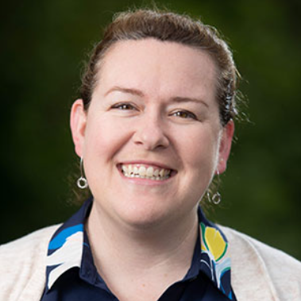
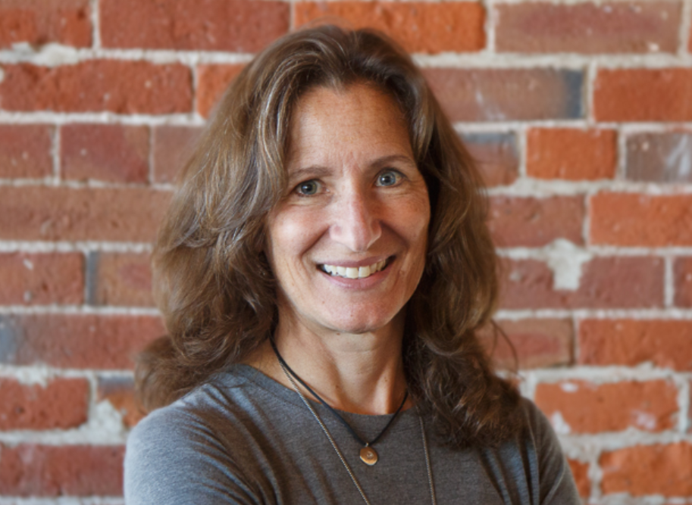
The Taste
Sept 23rd 7pm - 8pm Virtual Event
Moderator: Kate Fritz, CEO Alliance for the Chesapeake Bay
Guest Speaker: Lee Failing, Principal at Compass
Award Winners
Fran Flanigan Environmental Leadership Award
Chesapeake Watershed Champion Awards
Silent Auction
Raffle

Slide 3
The Taste
Taste Financial Goal is $90,000
Major source of unrestricted funding for the Alliance
Majority of income from sponsorships
Additional income from ticket sales and auction
Requesting Board support to enlist sponsors and help identify high value auction items
Will follow up in August with sample email to help promote ticket sales

Slide 4
50th Anniversary Fund Drive
Our 50th Anniversary Fund Drive will officially kick off at The Taste
This fund drive replaces the mid-year and year-end appeals
Our hope to raise a $50,000 Board Match
To date we have raised $41,000
3 Board Members have volunteered to conduct donor house parties
Would love to get some coverage in PA & Richmond / Southern VA area
More details about the Fund Drive will follow from Due East and the committee
Combined Taste and 50th Anniversary Fund Drive Goal is $200,000

